Slide 1

Tamasha : A Movie Booking Website
Team 5:
Manisha Jhunjhunwala
Shailesh Navale

Slide 2
Functionalities provided by our app
Register/ Login - Used django’s authentication model; user gets redirected to login page if he tries to access the homepage without logging in
Book Shows/ Movies - User can see the list of movies running and book a particular movie from the homepage
Filter Movies based on City, Theater and date - User can select movies based on a particular city, theater and date
Check Available Seats in a graphical manner - He can see the seats blocked and available and select the seats
Cancel Shows - He can see all his booking in one page and cancel his bookings from the same page

Slide 3
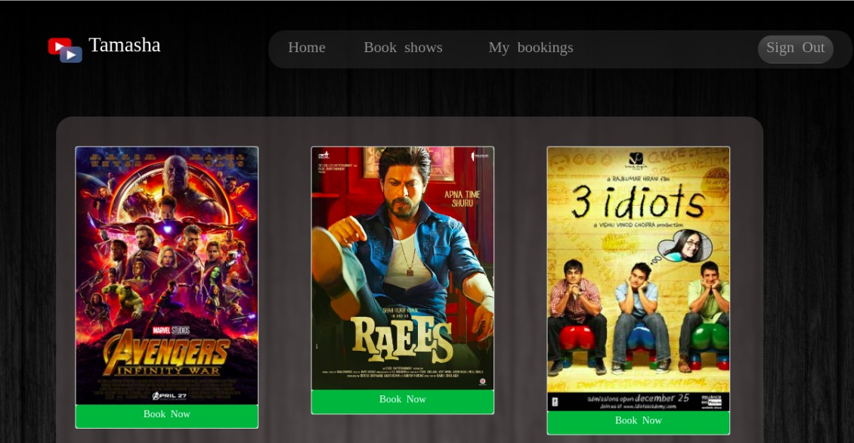
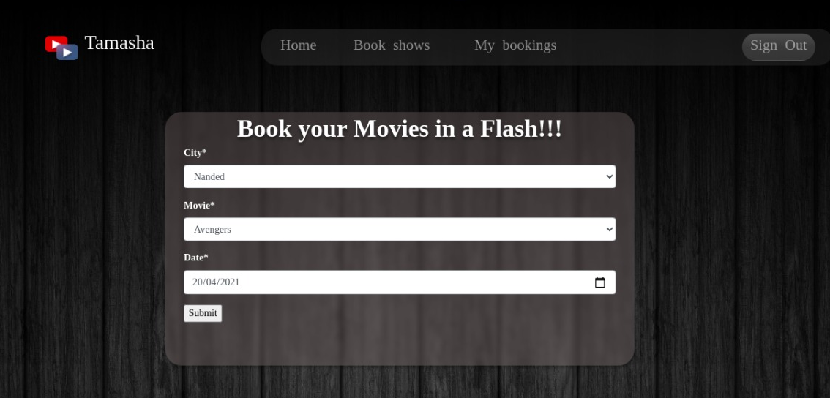
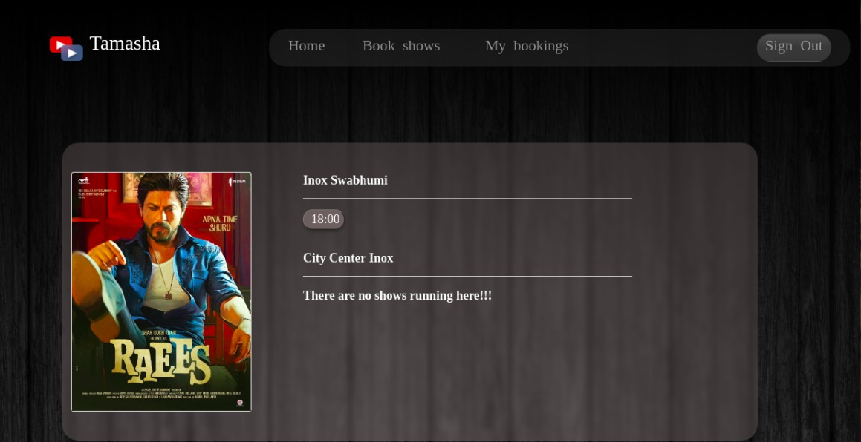
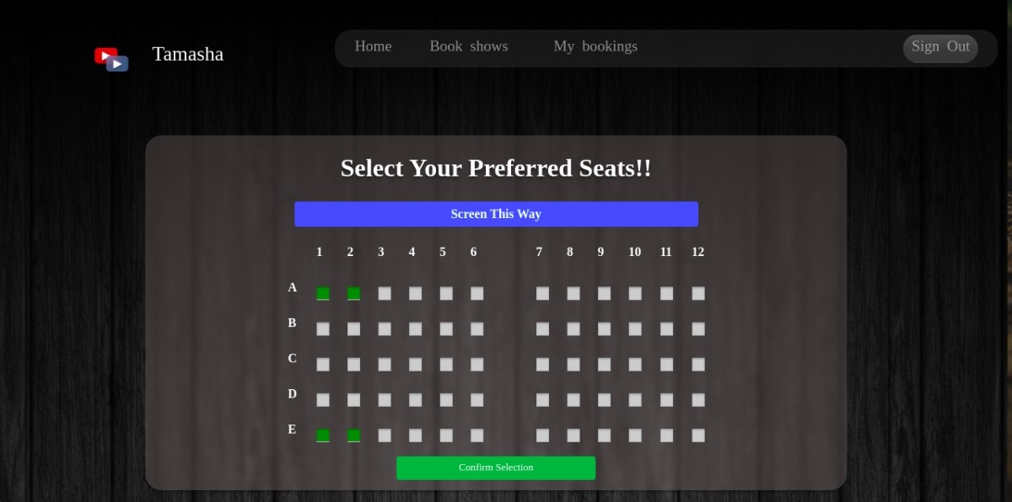

Slide 4
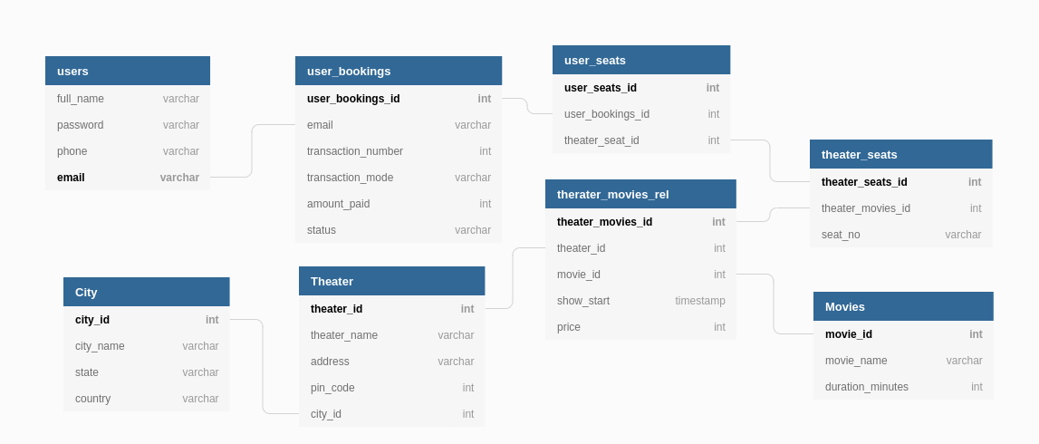
Database Schematic Architecture

Slide 5
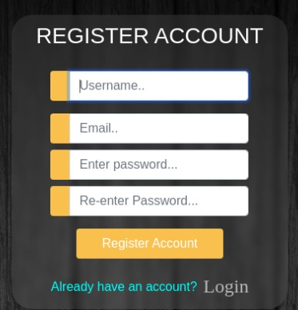
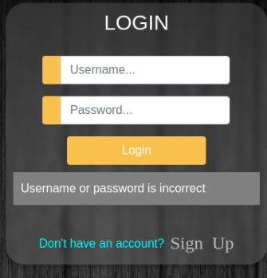
Key Aspects/Technologies used in the application
Django User Authentication Model
Method Base Views
Django Crispy forms
ORM model of querying database

Slide 6
Live Demo Video

